Slide 1
Non-functional Requirements
Mastering the Requirements Process: Getting Requirements Right, 3/e, Video Enhanced Edition – Chapter 11
IEEE Guide to SRS
Software Requirements, By: Karl E Wiegers and Joy Beatty, Publisher: Microsoft Press – Chapter II

Slide 2
Non-functional Requirements
1 Performance
2 Reliability
3 Availability
4 Security
5 Maintainability
6 Portability
…. (Etc…)

Slide 3
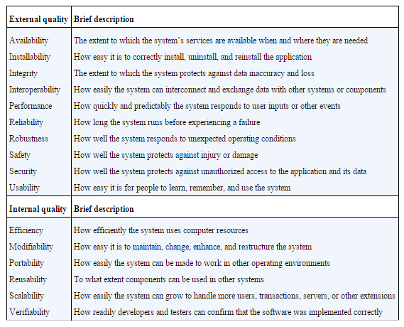

Slide 4
Why Non-Functional Requirements?
When you buy a cellular phone, which one will you choose and why?
The basic function is communication with another party

Slide 5
Beyond functionality
“Hi, Sam, this is Clarice. I’m presenting a class in the new training room today, but the heating system is terribly loud. I’m practically shouting over the fan and I’m getting hoarse. You’re the maintenance supervisor. Why is this system so loud? Is it broken?”
“It’s working normally,” Sam replied. “The heating system in that room meets the requirements the engineers gave me. It circulates the right amount of air per minute, it controls the temperature to within half a degree from 60 to 85 degrees, and it has all the requested profile programming capabilities. Nobody said anything about noise, so I bought the cheapest system that satisfied the requirements.”
Clarice said, “The temperature control is fine. But this is a training room! The students can hardly hear me. We’re going to have to install a PA system or get a quieter heating system. What do you suggest?”
Sam wasn’t much help. “Clarice, the system meets all the requirements I was given,” he repeated. “If I’d known that noise levels were so important, I could have bought a different unit, but now it would be really expensive to replace it. Maybe you can use some throat lozenges so you don’t lose your voice.”

Slide 6
Performance
Performance requirements are written when your product needs to perform some tasks in a
given amount of time,
some tasks need to be done to a specific level of accuracy, or
the product needs to have certain data storage capacity, or
it has to achieve a certain volume of throughput.

Slide 7
To note
Need for speed must be genuine
Example:
The system shall identify whether an aircraft is hostile or friendly within 0.25 second.
Capacity is another performance requirement
Example:
The system shall support 2,000 concurrent users.

Slide 8
Performance
Examples
PER-1. Authorization of an ATM withdrawal request shall take no more than 2.0 seconds.
PER-2. The anti-lock braking system speed sensors shall report wheel speeds every 2 milliseconds with a variation not to exceed 0.1 millisecond.
PER-3. Webpages shall fully download in an average of 3 seconds or less over a 30 megabits/second Internet connection.
PER-4. At least 98 percent of the time, the trading system shall update the transaction status display within 1 second after the completion of each trade.

Slide 9
Reliability
The probability of the software executing without failure for a specific period of time is known as reliability
Examples
REL-1. No more than 5 experimental runs out of 1,000 can be lost because of software failures.
REL-2. The mean time between failures of the card reader component shall be at least 90 days.

Slide 10
Availability
Availability is a measure of the planned up time during which the system’s services are available for use and fully operational
Availability equals the ratio of up time to the sum of up time and down time
Examples
AVL-1. The system shall be at least 95 percent available on weekdays between 6:00 A.M. and midnight Eastern Time, and at least 99 percent available on weekdays between 3:00 P.M. and 5:00 P.M. Eastern Time.
AVL-2. Down time that is excluded from the calculation of availability consists of maintenance scheduled during the hours from 6:00 P.M. Sunday Pacific Time, through 3:00 A.M. Monday Pacific Time.

Slide 11
Security
Security deals with blocking unauthorized access to system functions or data, ensuring that the software is protected from malware attacks, and so on
Examples
SEC-1. The system shall lock a user’s account after four consecutive unsuccessful logon attempts within a period of five minutes.
SEC-2. The system shall log all attempts to access secure data by users having insufficient privilege levels.
SEC-3. A user shall have to change the temporary password assigned by the security officer to a previously unused password immediately following the first successful logon with the temporary password.
SEC-4. A door unlock that results from a successful security badge read shall keep the door unlocked for 8.0 seconds, with a tolerance of 0.5 second.
SEC-5. The resident antimalware software shall quarantine any incoming Internet traffic that exhibits characteristics of known or suspected virus signatures.
SEC-6. The magnetometer shall detect at least 99.9 percent of prohibited objects, with a false positive rate not to exceed 1 percent.

Slide 12
Maintainability
The ability to change the system to deal with new technology or to fix defects
Examples
Installation of a new version shall leave all database contents and all personal settings unchanged
No method in any object may exceed 200 lines of code
The product shall provide facilities for tracing any database field to places where it is used

Slide 13
Portability
The effort needed to migrate software from one operating environment to another is a measure of portability
Portability has become increasingly important as applications must run in multiple environments, such as Windows, Mac, and Linux; iOS and Android; and PCs, tablets, and phones
Examples
POR-1. Modifying the iOS version of the application to run on Android devices shall require changing no more than 10 percent of the source code.
POR-2. The user shall be able to port browser bookmarks to and from Firefox, Internet Explorer, Opera, Chrome, and Safari.
POR-3. The platform migration tool shall transfer customized user profiles to the new installation with no user action needed.

